Slide 1
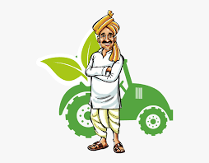
A Capstoneproject report on Agriculture Helping
Prepared by
Harivansh Nitin Vinchurkar
Dev Kamlakar Kalaskar
Gajanan Rajendra Patil

Slide 2
A Microproject on Agriculture Helping Project Guide Mrs. Ganesh Palve
Roll No | Name | Enrollment Number
58 | Harivansh Nitin Vinchurkar | 2105090033
60 | Dev Kamlakar Kalaskar | 2105090047
61 | Dev Kamlakar Kalaskar | 2205090197

Slide 3
Introduction
Agriculture is the backbone of India. More than 60% of Indian workers are involved in Agriculture. E-marketing is referred to those strategies and techniques which use online ways to reach target customers. E-Marketing is also known as Digital Marketing, or Online Marketing. E-marketing is the way to sell products over Internet. Farmers may use the Internet to sell products to customer and organizations. E-marketing is useful to the farmers as its serve customer all over the world 24*7. The cost incurring is also low. Agriculture Helping’s e-Market will serve as a way for the sellers to sell their products across the country just with some basic knowledge about how to use the website. The site will guide the farmers in all the aspects.

Slide 4
Existing System
In the existing system all transactions, dealings of products, purchasing of products were done manually which is time consuming.
Reports are prepared manually as and when needed. Maintaining of reports is tedious task
To buy any product user has to collect information about it either by visiting the shop or by asking people which is better.
There is no computer system for handling payments. All calculations are performed manually which may not always be accurate. Maintaining records is difficult.
Any internet user can use this existing website to search for any kind of products, select particular product from wide range of products

Slide 5
Proposed System
The central concept of the application is to allow the buyer to shop virtually using internet and allow customers to buy products of their own choice.
Improve the services of buyers and producers eliminating the middlemen between them.
Maintaining details of customer payments, product receipts, and also updation of the same.
The information pertaining to the products are stored on RDBMS at the server side. The server process the customers and the items are shipped accordingly
Capable of storing all the day to day transactions
Since, all the data are stored in the database analysis of data can be done. The admin can keep record of what product is sold to which buyer from which farmer. Every data can be accessed and analysis can be done which will help in generation of reports for future use

Slide 6
Modules
Admin:
The Admin is the super user of the system. The Admin is responsible for maintaining and managing the website.The Admin is responsible for checking every single transaction, from updation of produce by farmers to selling of produce to buyers
Buyers:
Online farmers market helps you work with farms and food hubs all in one place. Maintain and manage existing relationships, discover and create new ones and bring the efficiency of an online system to your local food sourcing
Sellers
Sellers can sell their product under the different categories.They have to simply register on website and make communications with an admin.

Slide 7
Technologies Used In Agriculture Helping
HTML
HTML or Hypertext Mark-up Language is a standard mark-up language for web application development. Web browsers read HTML files and convert them to graphical item son viewport.
JavaScript
provides the behavioural of the web elements included in HTML. It also provides data binding for the HTML elements. Also, JavaScript provides a way to make client side validtions
CSS
CSS or Cascade Style Sheet is a way to create a look to HTML elements. This makes the page more interactive as compared to plain HTML elements. Along with this bootstrap framework also provide an effective way for designing
PHP
PHP can actually do anything related to server-side scripting or more popularly known as the backend of a website. For example, PHP can receive data from forms, generate dynamic page content, can work with databases, create sessions, send and receive cookies, send emails etc.

Slide 8
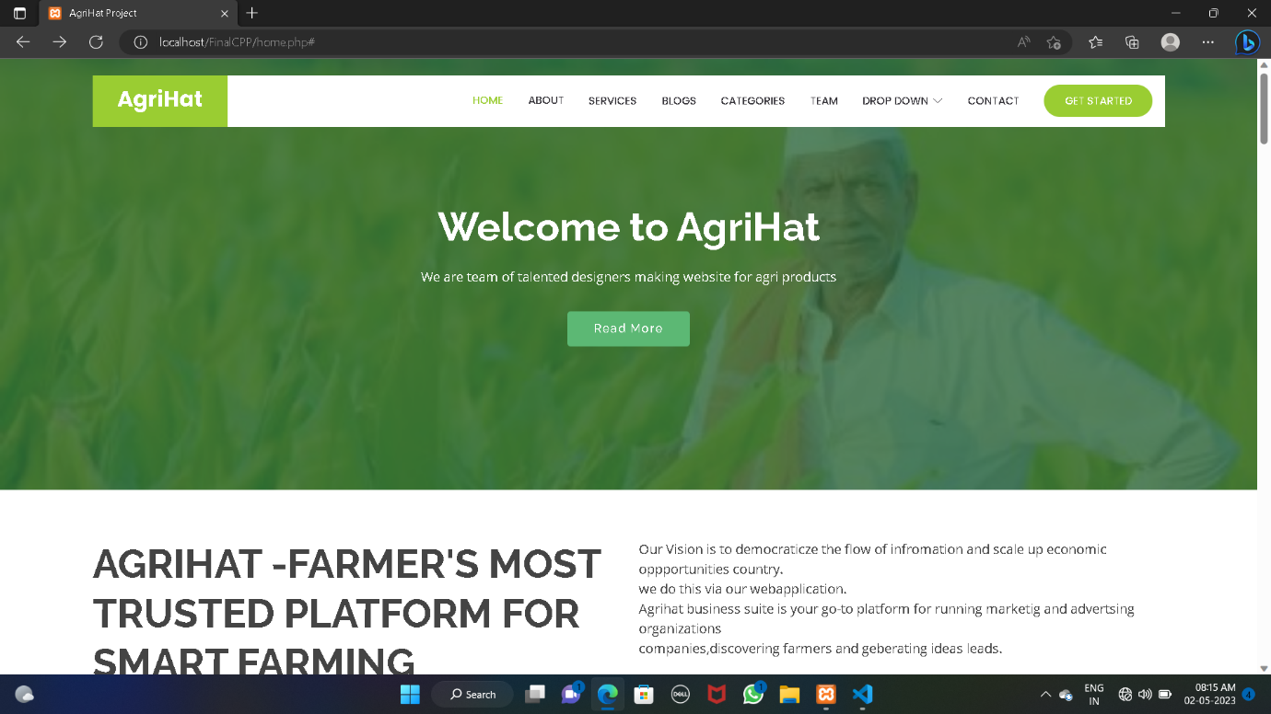
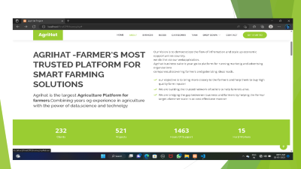
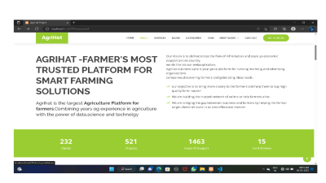
Outputs

Slide 9
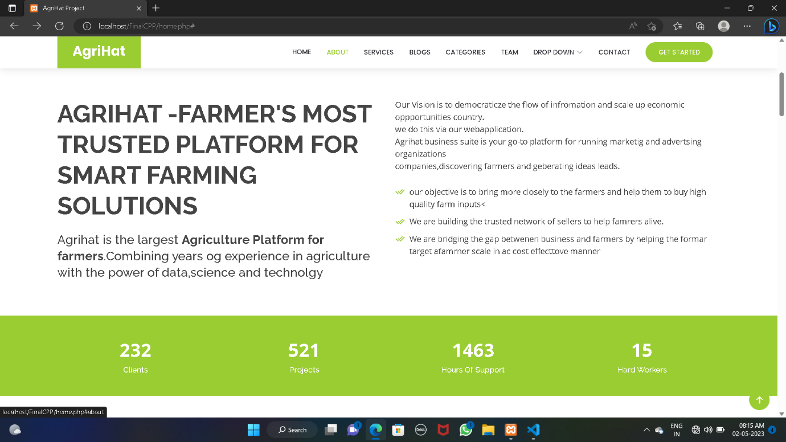

Slide 10
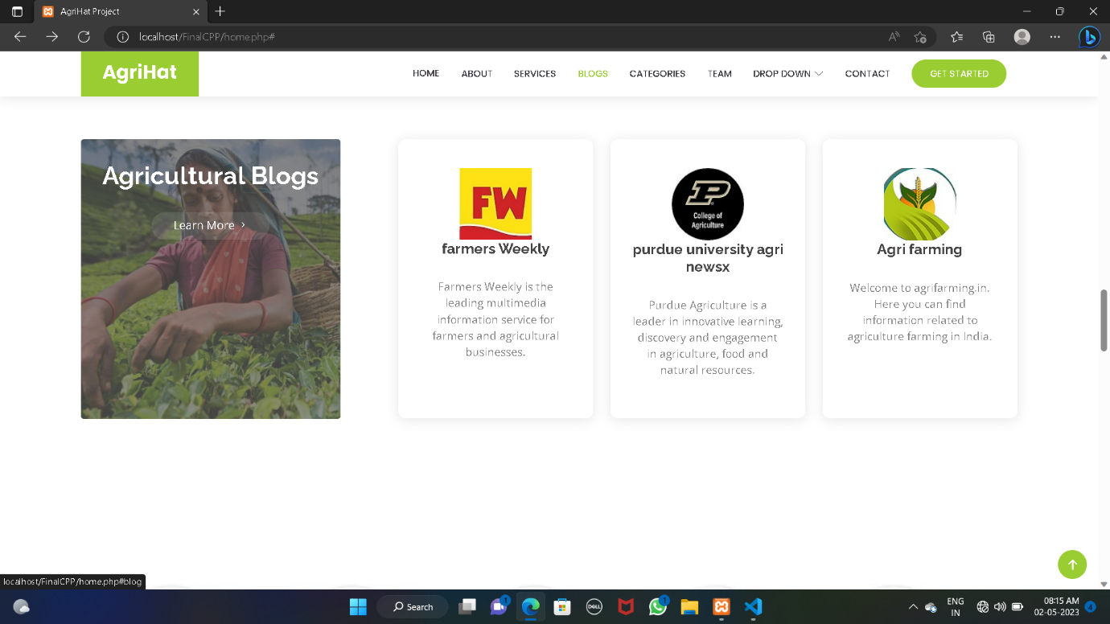

Slide 11
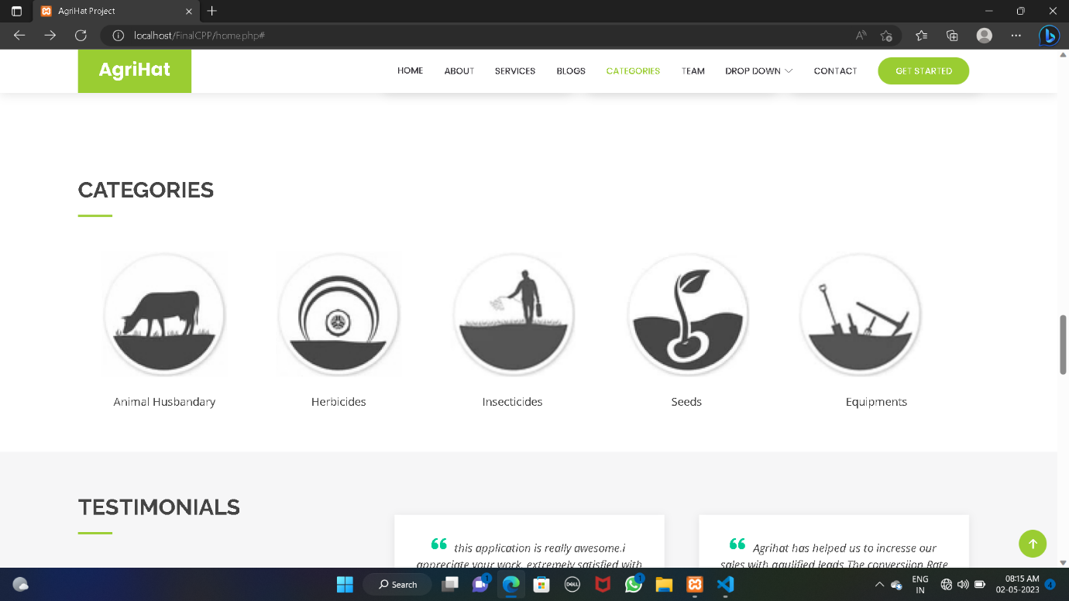

Slide 12
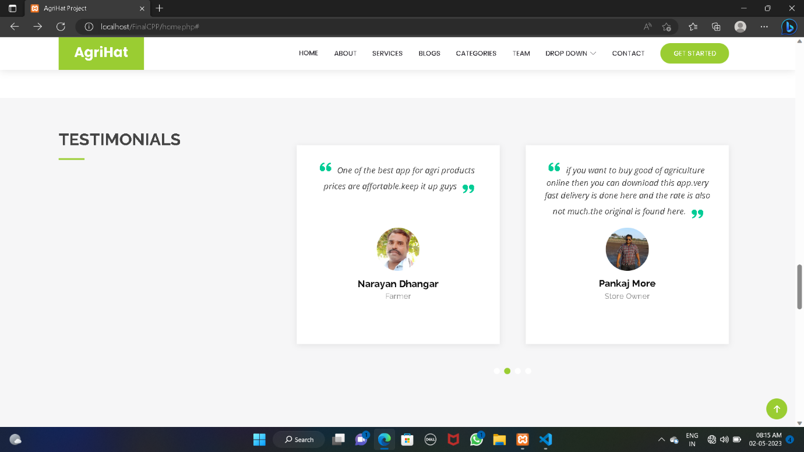

Slide 13
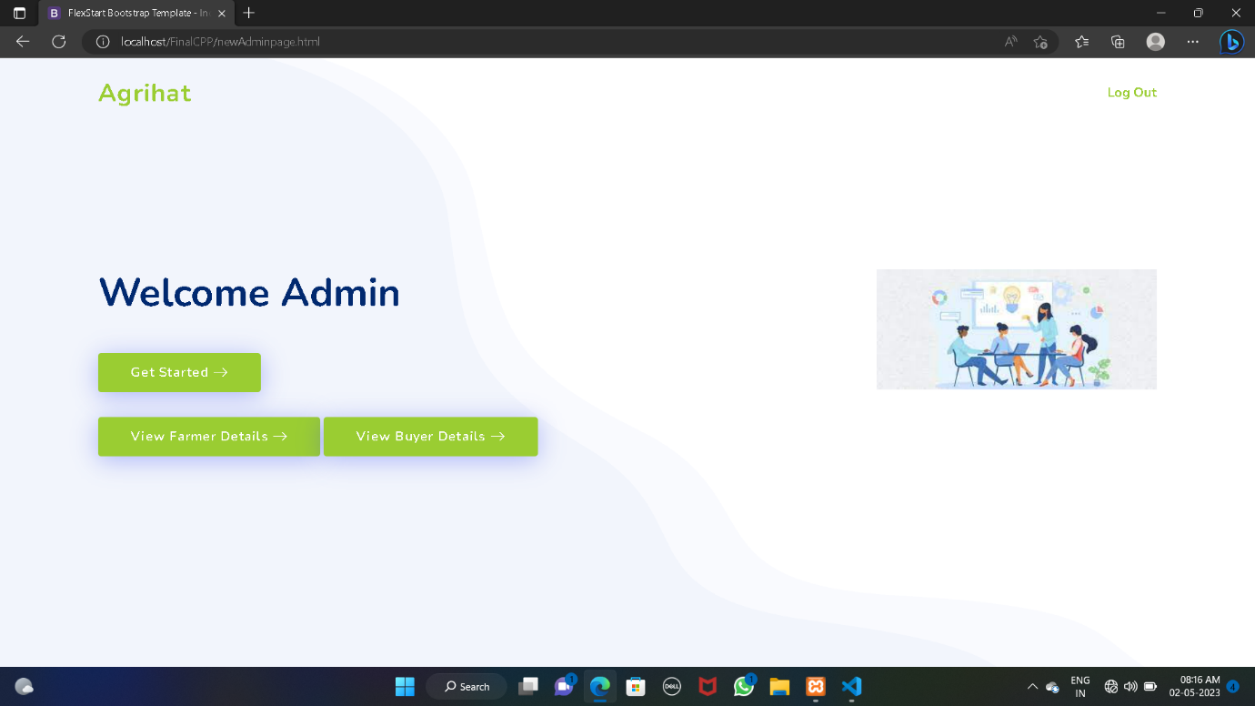
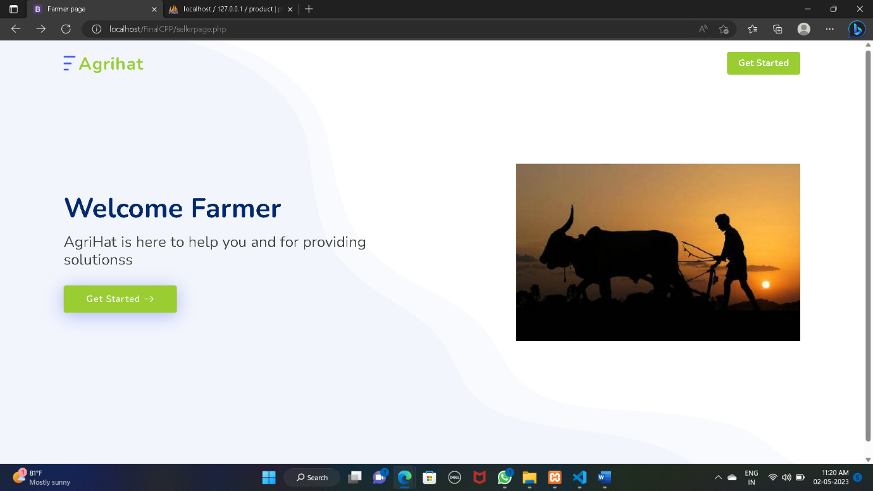

Slide 14
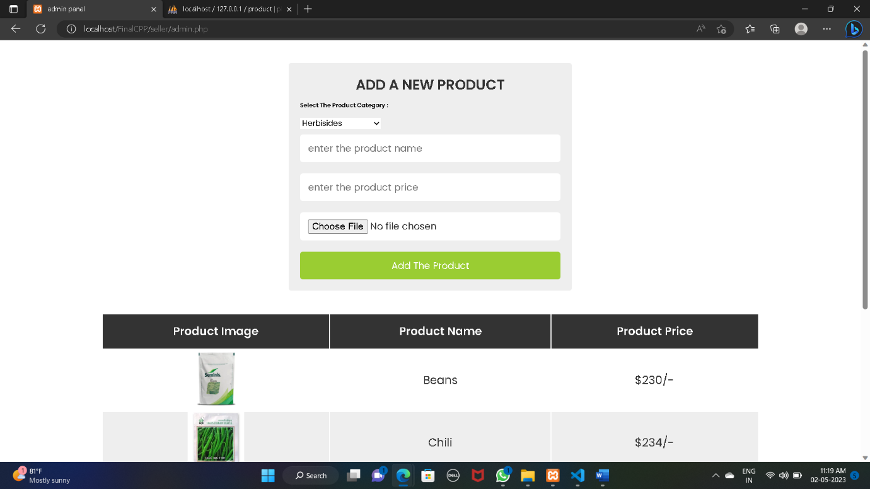

Slide 15
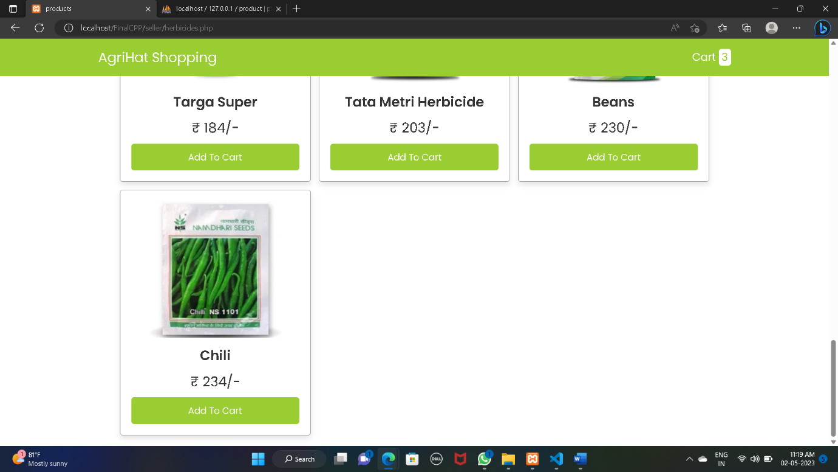

Slide 16
Conclusion
In this way ,We learnt that how the real world projects work.
The main objective for the project was to provide dynamic online E-farming system to help farmers in every possible way and provide them a stable platform where ther can perform every transaction at ease.
This project helps in understanding the creation of an interactive web page and the technologies used to implement it. The building of the project has given us the idea and a precise knowledge about how the application can be developed , how it connects to the database and how the data and web pages are modified as required.

